Slide 1
Computer Vision
Traffic Sign Recognition
German Traﬀic Sign Recognition Benchmark (GTSRB)
Presenters: Anqi Shen, Erdun E, Jingjing Lin

Slide 2
1
Introduction
2
Background
3
Methodology
OUTLINE
4
Results
5
Discussion
6
Conclusion

Slide 3
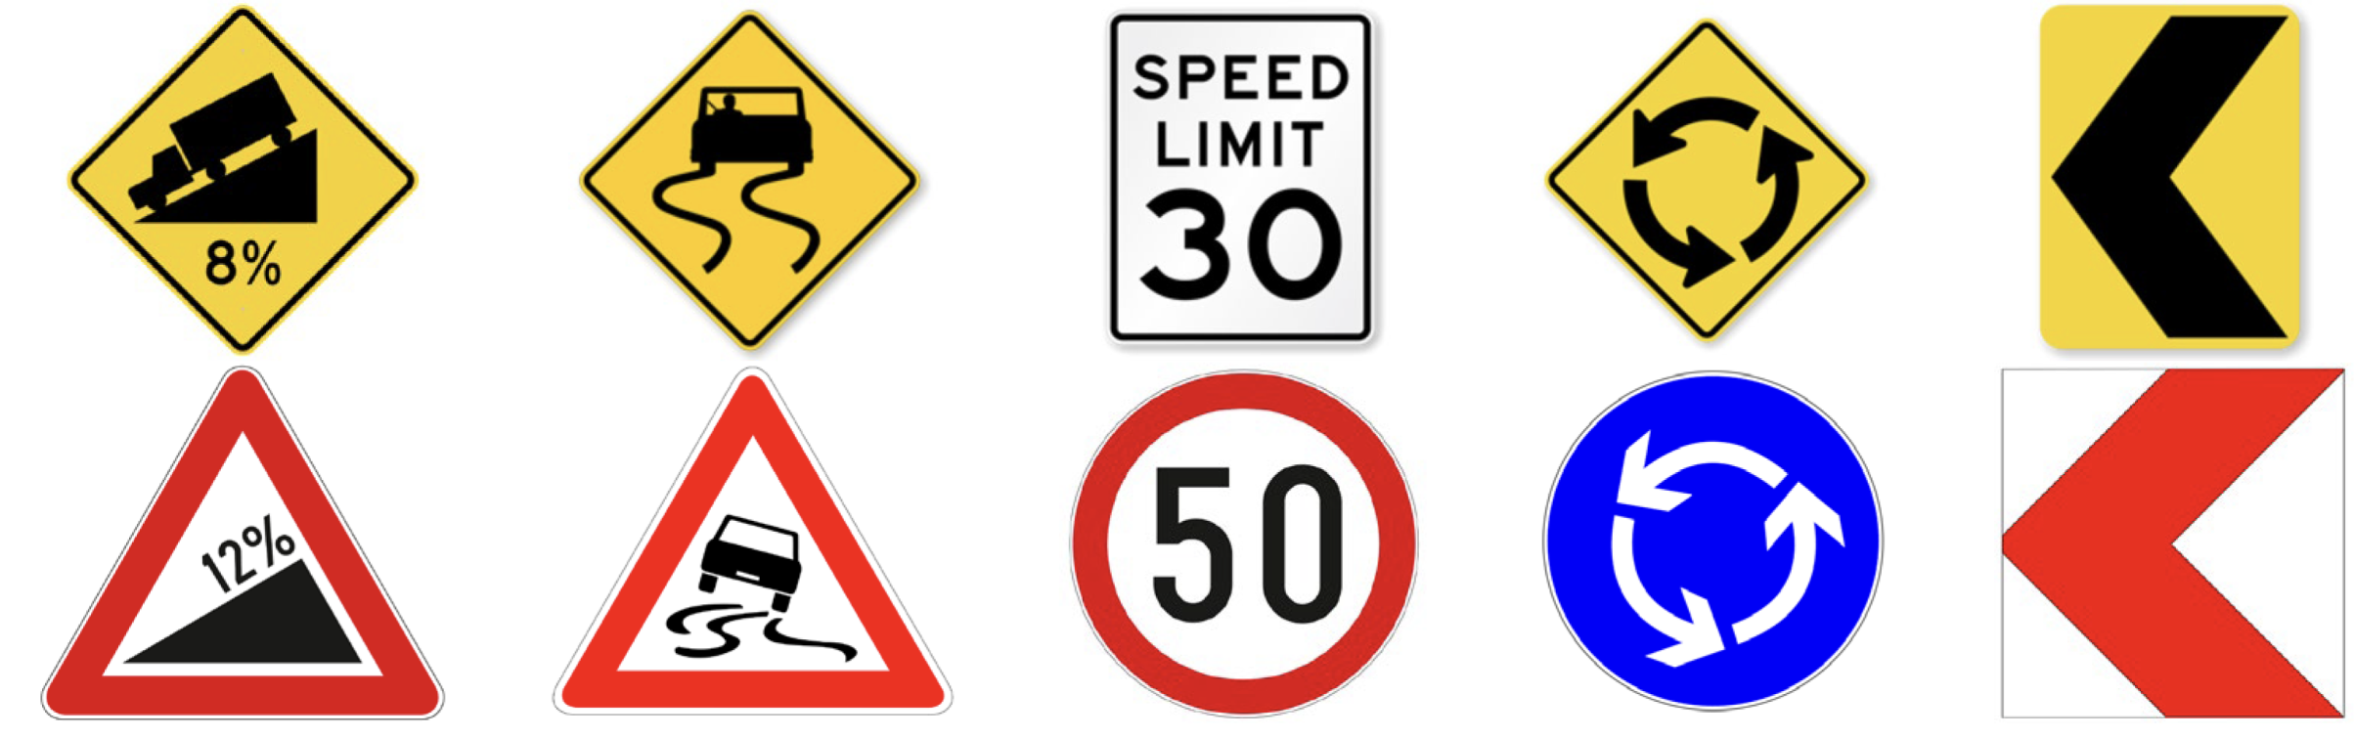
Traffic sign recognition is the task of automatically detecting and classifying traffic signs from images or video frames.
Plays a critical role in intelligent transportation systems by helping
vehicles understand and respond to road conditions.
Aims to develop a deep learning–based traffic sign recognition model using the German Traffic Sign Recognition Benchmark (GTSRB) dataset.
Introduction
Background
Methodology
Results
Discussion
Conclusion

Slide 4
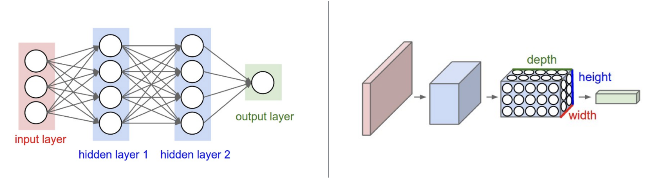
Traffic sign recognition has been widely studied in the field of computer vision, especially for intelligent transportation and autonomous driving.
Early approaches relied on classical image processing techniques.
With the rise of deep learning, Convolutional Neural Networks (CNNs) have become the dominant approach for traffic sign classification tasks.
Employ data preprocessing techniques such as image normalization, label encoding, and data augmentation to improve model generalization.
Introduction
Background
Methodology
Results
Discussion
Conclusion

Slide 5
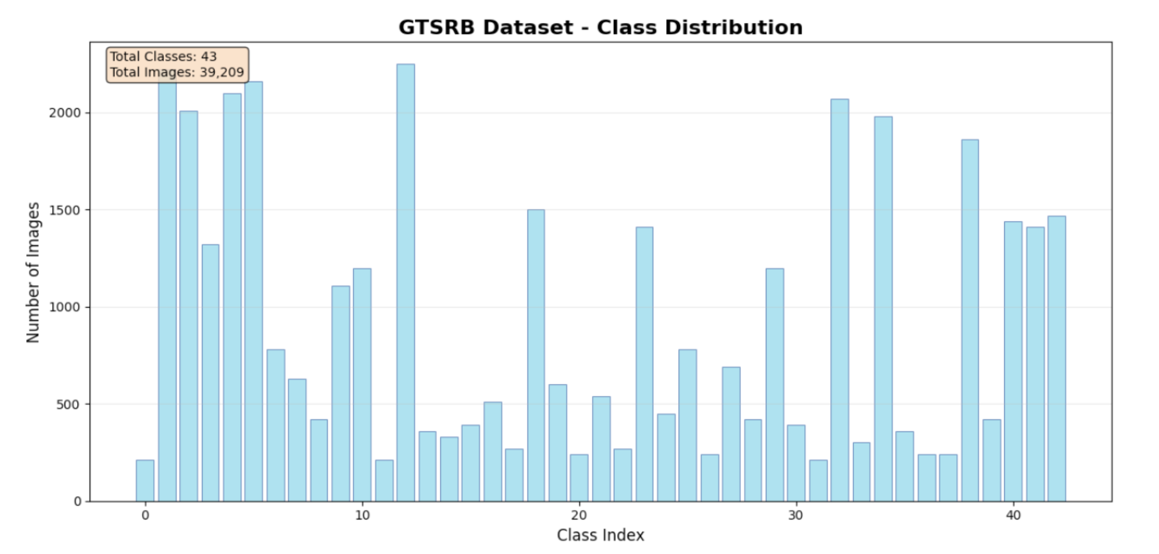
Technique: Python and several popular ML and CV frameworks
PyTorch, Torchvision, OpenCV, Local Anaconda, Matplotlib & Seaborn
Dataset: German Traffic Sign Recognition Benchmark (GTSRB)
Over 39,209 labeled images across 43 traffic sign classes
Preprocessing includes: image resizing, normalization, label encoding, data augmentation, Train-validation-test split, custom CNN, Transfer Learning (ResNet18)
Introduction
Background
Methodology
Results
Discussion
Conclusion

Slide 6
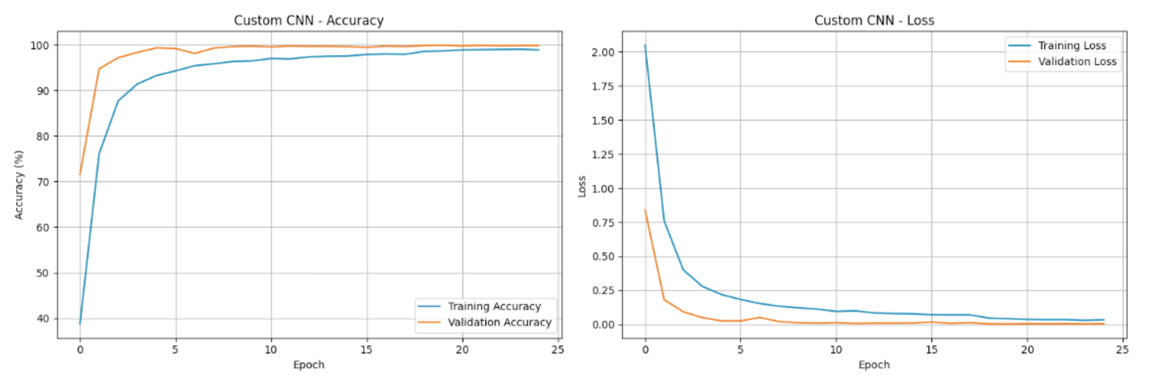
Introduction
Training and validation accuracy and loss curves for the custom CNN over 25 epochs, demonstrating stable convergence and high validation accuracy.
Background
Methodology
Results
Discussion
Conclusion

Slide 7
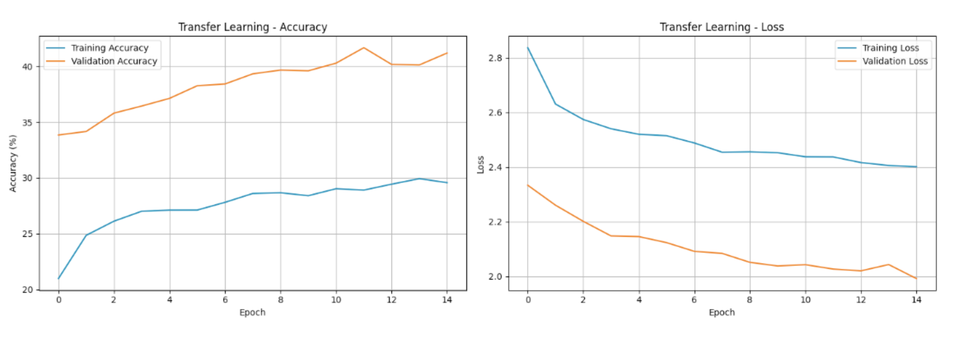
Introduction
Training and validation accuracy and loss curves for the transfer learning approach using ResNet18, showing limited performance due to small input resolution.
Background
Methodology
Results
Discussion
Conclusion

Slide 8
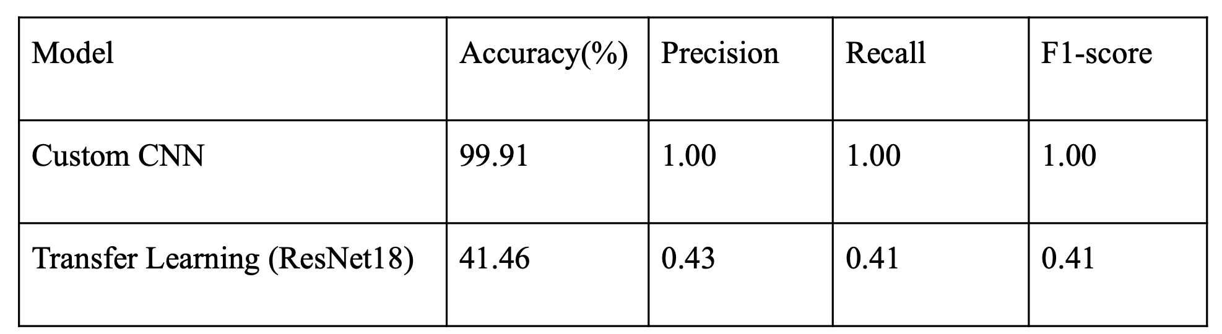
Main evaluation metrics
Introduction
Background
Methodology
Results
Custom CNN achieved exceptional performance with 99.91% accuracy.
While the transfer learning model performed poorly.
Primarily caused by the low input resolution (32×32), which makes it difficult for a deep pretrained model like ResNet18 to extract meaningful features.
Discussion
Conclusion

Slide 9
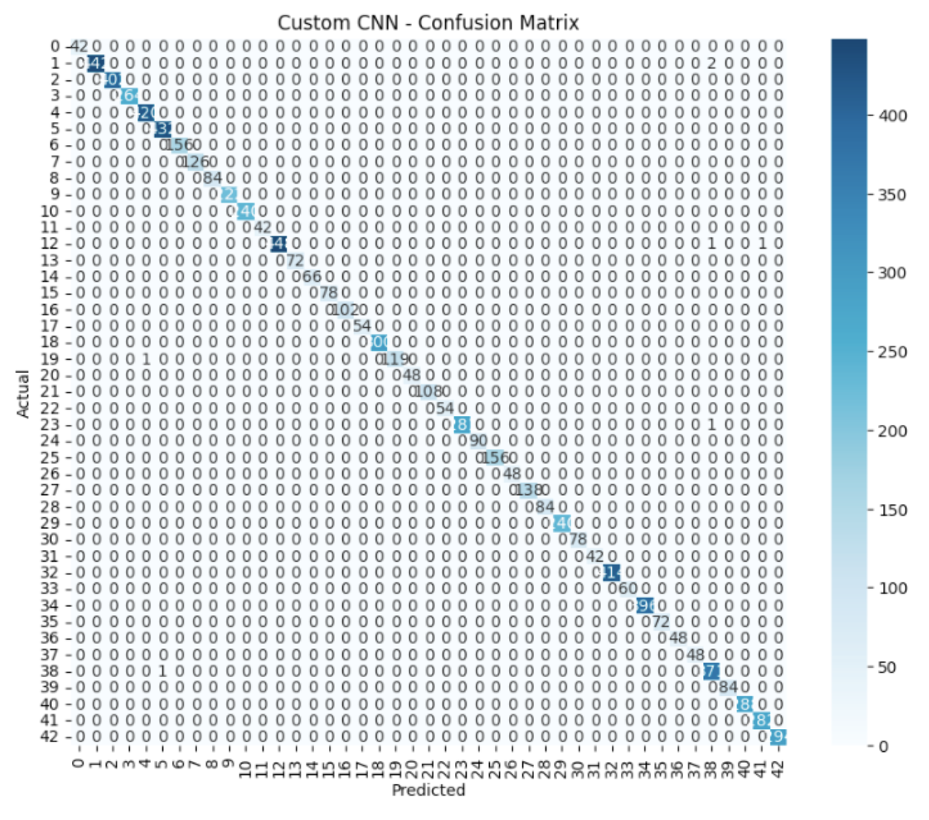
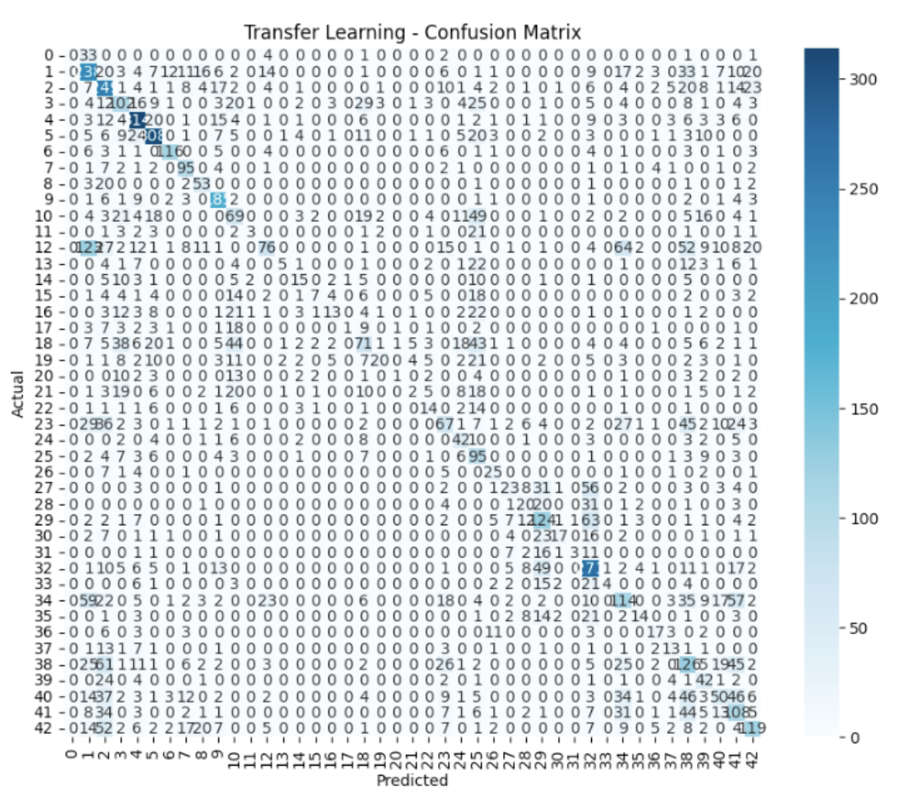
To better visualize the classification performance, we examined the confusion matrix of the custom CNN.
Introduction
Background
Methodology
Results
Discussion
Conclusion

Slide 10
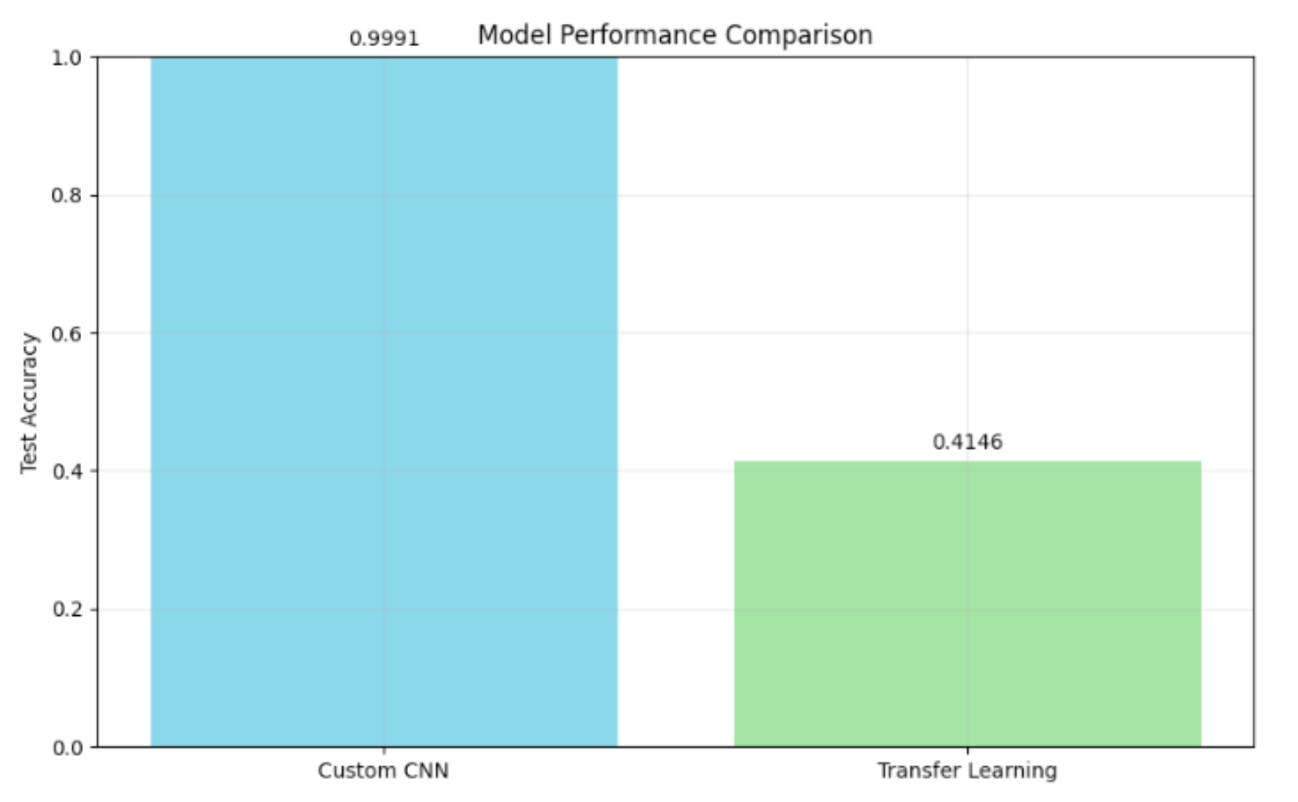
Also compared the test accuracy of the two models using a bar chart.
Introduction
Background
Methodology
Results
Discussion
Finally, we present example outputs of our model, showing the predicted class and top-5 probabilities for each input traffic sign.
Most predictions are correct, rare misclassifications occur mostly among triangular warning signs that share similar colors and shapes.
Conclusion

Slide 11
Introduction
Limitations​
Risk of overfitting
Real-world performance drop
High resource demands
​
Interpretation of results​
High overall accuracy
Misclassifications due to visual similarity
​
Potential improvements​
Adopt deeper architectures: e.g., ResNet or EfficientNet
Enhance data augmentation
Optimize training: e.g., grid search or Bayesian optimization
Background
Methodology
Results
Discussion
Conclusion

Slide 12
Introduction
✅ Summary of Achievements
Successfully built an end-to-end AI pipeline.
Designed a custom CNN model that achieved 99.91% accuracy.
Applied effective techniques such as data preprocessing, class balancing, and augmentation to enhance model performance.
🎓 Lessons Learned
Gained hands-on experience in developing and optimizing CNN architectures for image classification tasks.
Learned the importance of proper data handling.
Understood how visual similarity can lead to classification errors, highlighting the need for discriminative features.
Experienced the benefits of collaborative teamwork.
Background
Methodology
Results
Discussion
Conclusion

Slide 13
REFERENCES
Pauwels, E., Smith, J., Johnson, A., & Brown, K. (2020). Real-time traffic sign detection and recognition in autonomous driving systems. IEEE Transactions on Intelligent Transportation Systems, 21(12), 5104–5115.
Stallkamp, J., Schlipsing, M., Salmen, J., & Igel, C. (2011). The German traffic sign recognition benchmark: A multi-class classification competition. In Proceedings of the International Joint Conference on Neural Networks (pp. 1453–1460). IEEE.
xGodlike0. (2024). Traffic signs recognition [Computer software]. GitHub. https://github.com/xGodlike0/TRAFFIC-SIGNS-RECOGNITION
Kaggle. (2025). German Traffic Sign Recognition Benchmark (GTSRB) [Dataset]. Kaggle. https://www.kaggle.com/datasets/meowmeowmeowmeowmeow/gtsrb-german-traffic-sign
DeepLearningTutorials. (2024, March 15). Traffic sign recognition using deep learning | CNN | Python [Video]. YouTube. https://www.youtube.com/watch?v=eS8sE1M9dks

